Slide 1

What is Australia like?
オーストラリアって
どんな国？
先生の名前
Teacher’s name

Slide 2
Slide for quick self introduction
Insert your photo (Photos from your childhood or school days are good starters for the class.)

Slide 3

GOOD DAY
G’DAY!

Slide 4

G’DAY!
My name is _____.

Slide 5
Possum Magic
ポスおばあちゃんのまほう

Slide 6
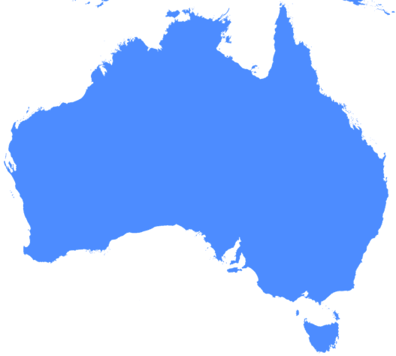

Slide 7
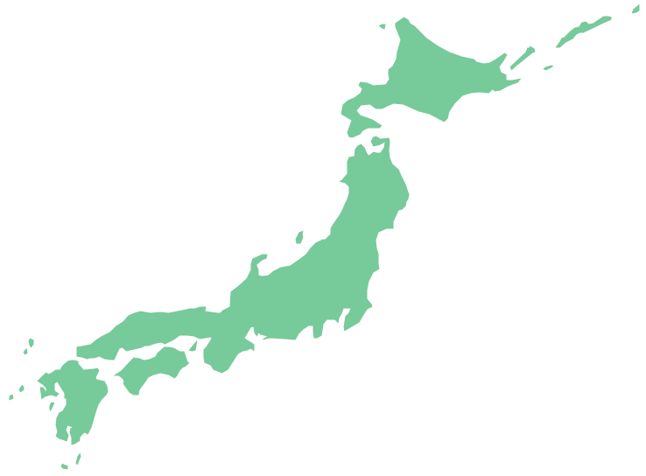

Slide 10
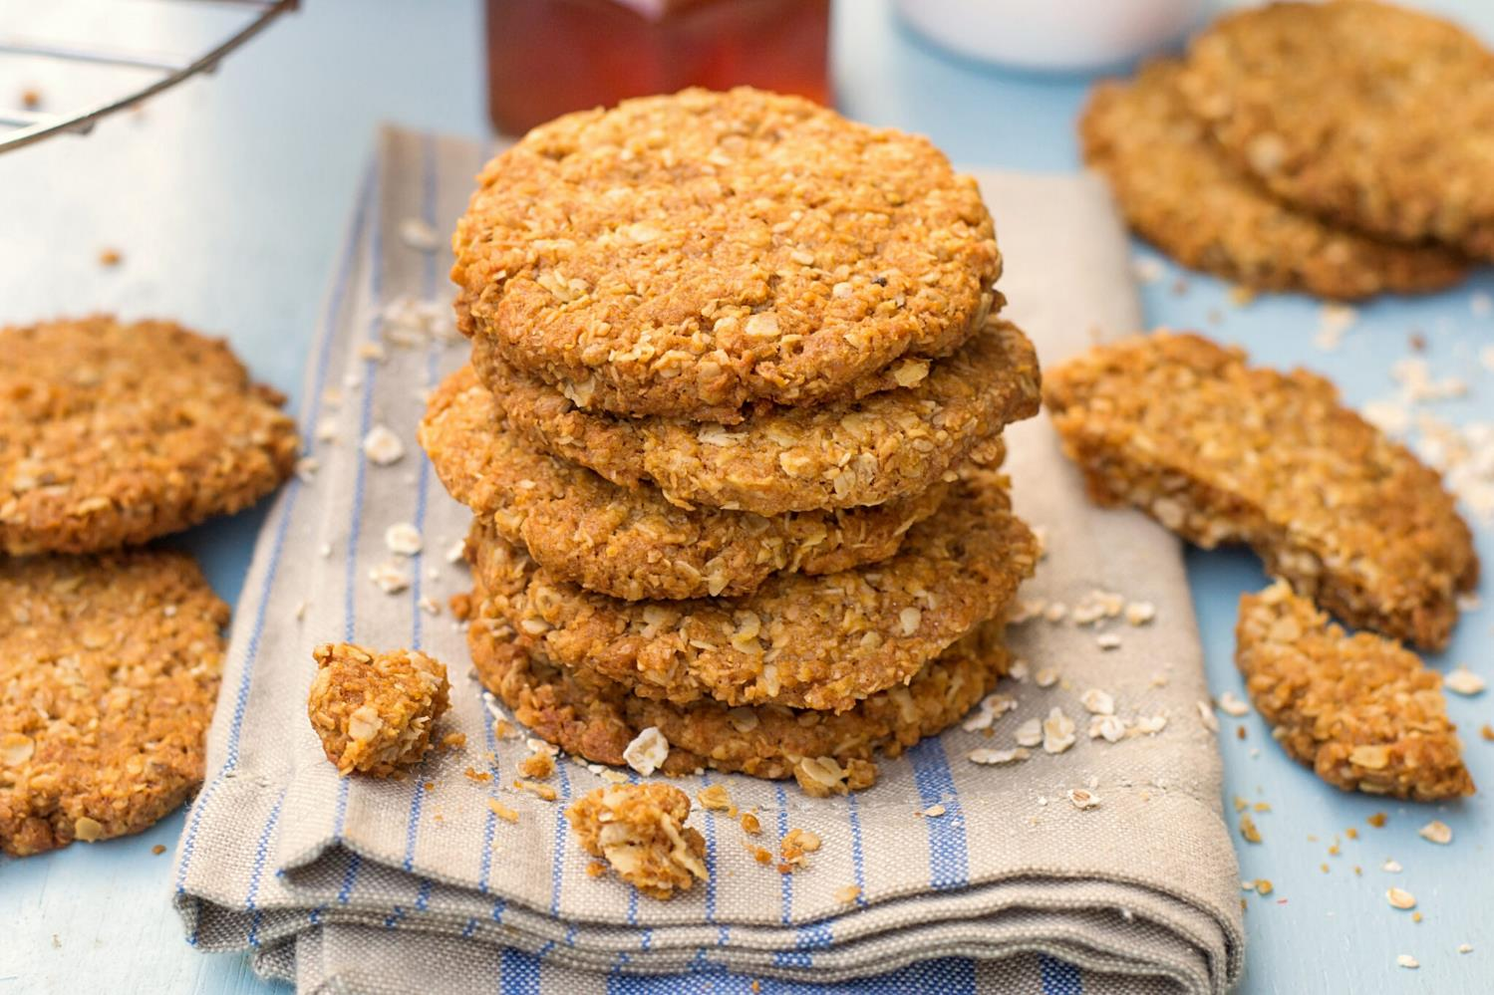

Slide 11
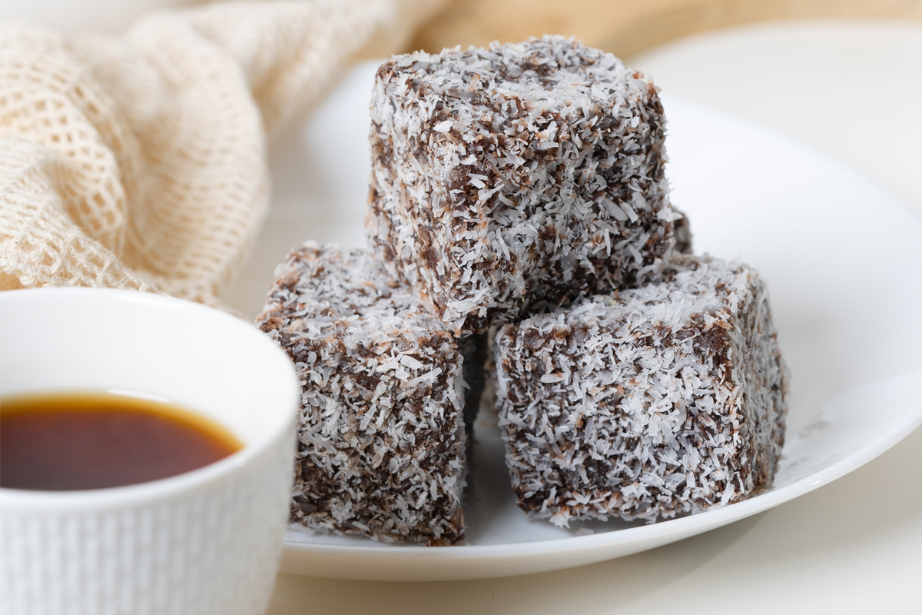

Slide 12
THANK YOU!

